Slide 1

CRIME ANALYSIS USING SUPERVISED LEARNING
Guided by, Prof. JAYAKUMAR S
Assistant Professor School of Information Technology
Vellore Institute of Technology
Submitted by,
SABYASACHI CHAKRABORTY
Registration no - 18MCA0234
PRATIK KUMAR DUTTA
Registration no - 18MCA0203
SAHIL GANDHE
Registration no - 18MCA0207

Slide 2
Abstract
This presentation describes that Crime analysis is performed using comparison of Naive Bayesian Classification, Random Forest, Support Vector Machine(SVM) Algorithm. In this technique, team has calculated and given the result of the accuracy for the provided terms and data. System is able to get prediction automatically with this approach and approximate outcome for a big division of Crime analyzed data and expressions by comparing and deploying efficient algorithms that are significantly better and thereby achieving results in minimal span of time.

Slide 3
Introduction
Data mining and machine learning have become a vital part of crime detection and prevention
Different application like Crime detection and Crime identification, Crime prediction, Selection and Crime Rate analysis can be done using: 1. Naive Bayesian, 2. Random Forest and 3. Support Vector Machine
Based on accuracy we can easily find out the area where crime rate is more and can take proper action in those crime zone before any criminal activity.

Slide 4
Literature Survey
Authors | Proposed Model | Advantages | Disadvantages
[1]Shiju Sathyadevan, Surya Gangadharan S. YEAR- 2014 | Crime analysis and prediction the probability using Naïve Bayesian classifier | This setting is motivated by many cases in which there exist laws that disallow a decision that is partly based on discrimination | Cannot handle large and complex dataset accurately
[2] Alves, Luiz GA, Haroldo V. Ribeiro YEAR-2018 | Crime prediction through urban metrics and statistical learning | produce more robust conclusions regarding the effects of urban indicators on crime, having potential applications for guiding public policies for crime control | While it is a hard task to extract causality from data, several linear models have been proposed to predict crime
[3] Al-Janabi, Kadhim B. Swadi YEAR-2011 | Proposed Framework for Analyzing Crime Data Set Using Decision Tree | The preprocessed data were used to find out different crime and criminal trends and behaviors, and crimes and criminals were grouped into clusters according to their important attributes | Complex and involve high level mathematics that requires a statistical program to analyze the data

Slide 5
Literature Survey
Authors | Proposed Model | Advantages | Disadvantages
[4Agrawal, R., Imielinski, T. and Swami, A YEAR- 1993 | CLUSTERING AND ASSOCIATION RULE | Association-rule mining has been a powerful tool for discovering correlations among massive databases | Sometimes there are difficulties with efficiency, effectiveness and degree of autonomy in clustering methods
[5]Keyvanpour, Mohammad Reza, Mostafa Javideh, and Mohammad Reza Ebrahimi. YEAR-2011 | CRIME MATCHING FRAMEWORK | government agency by digging and analyzing records of the financial transaction to build patterns that can detect money laundering or criminal activities | Complex and involve high level mathematics that requires a statistical program to analyze the data
[6] Shyam Varan Nath YEAR-2006 | Crime Pattern Detection Using Data Mining | to improve the productivity of the detectives and other law enforcement officers | Some of the limitations of our study includes that crime pattern analysis can only help the detective, not replace them

Slide 6
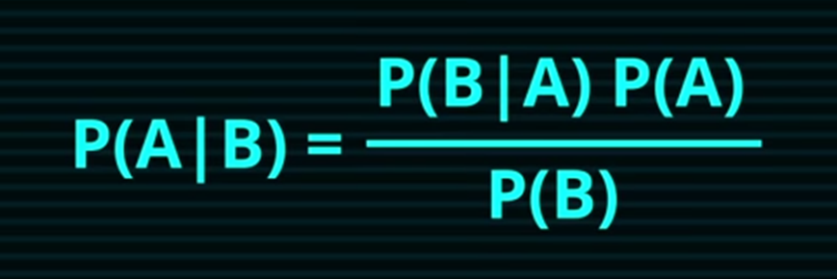
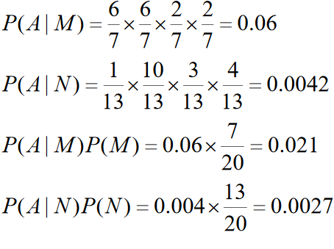
Naive Bayes
Naive Bayesian Classifier formula –
P= probability
A=first object
B= Second object
An example -

Slide 7
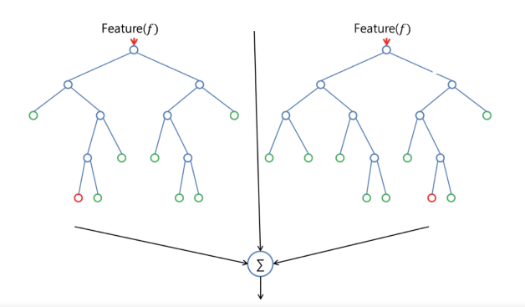
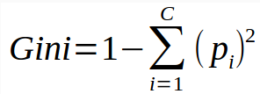
Random Forest Algorithm–
Random forest builds multiple decision trees and merges them together to get a more accurate and stable prediction
Using Gini Split / Gini Index
p= probability

Slide 8
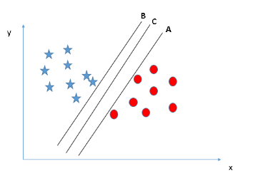
Support Vector Machine
Support Vector Machine(SVM) is a supervised machine learning algorithm which can be used for both classification or regression challenges
h_{w,b}(x) = g(w ^{T} x + b)

Slide 9
Proposed Model
In this model we analysis data based on Naive Bayesian, Random Forest and Support Vector Machine(SVM).
All the three classifiers are supervised which requires the class label for training an testing the data.
The advantage of using this model is to improve the accuracy prediction.
Weighted majority voting is used to predict the final accuracy from all the classifiers.

Slide 10
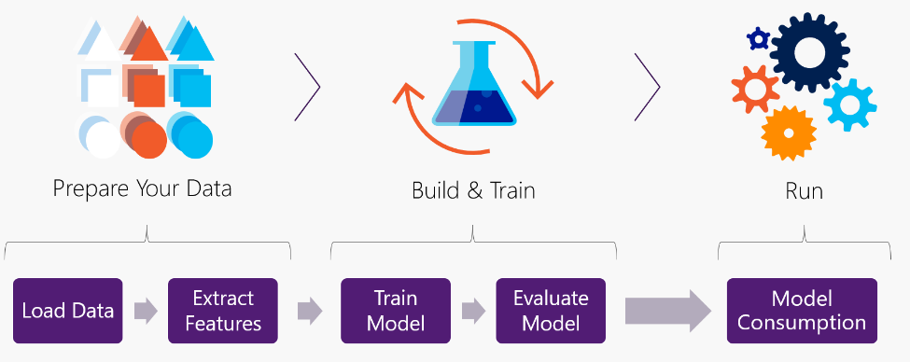
Proposed Architecture

Slide 11
Modules
1. Data Pre-processing
2. Naive Bayesian prediction
3. Random Forest prediction
4. Support Vector Machine
5. Compare the result based on accuracy
6. Analyze the performance

Slide 12
Performance Metrics
Accuracy: Accuracy is the most intuitive performance measure and it is simply a ratio of correctly predicted observation to the total observations.
Accuracy = TP+TN/TP+FP+FN+TN
Precision: Precision is the ratio of correctly predicted positive observations to the total predicted positive observations
Precision = TP/TP+FP
Recall: Recall is the ratio of correctly predicted positive observations to the all observations in actual class
Recall = TP/TP+FN
Here, TP= True Positive
TN=True Negative
FP=False Positive
FN=False Negative

Slide 13
Implementation Plan
We implement the Naïve Bayesian, Random Forest and Support Vector Machine on a dataset. First we train using dataset and based on the accuracy we choose
the best algorithm .
If we can find after ensemble two or more algorithm it will give best result the we will also implement ensemble technique.

Slide 14



Result
RANDOM FOREST:
NAIVE BAYES:
SVM

Slide 15
Results
After comparing two techniques one by one with each other we can come to the conclusion that:
SVM giving better accuracy like 80.72% among Random forest and Naïve Bayesian Classifier
After SVM (Support Vector Machine) Random Forest giving better Accuracy with 80.12%
At the End Naïve Bayesian Classifier comes with 76% Accuracy

Slide 16
References
[1] Sathyadevan, Shiju, and Surya Gangadharan. "Crime analysis and prediction using data mining." 2014 First International Conference on Networks & Soft Computing (ICNSC2014). IEEE, 2014.
[2] Alves, L.G., Ribeiro, H.V. and Rodrigues, F.A., 2018. Crime prediction through urban metrics and statistical learning. Physica A: Statistical Mechanics and its Applications, 505, pp.435-443.
[3] Al-Janabi, Kadhim B. Swadi. "A proposed framework for analyzing crime data set using decision tree and simple k-means mining algorithms." Journal of Kufa for Mathematics and Computer 1.3 (2011): 8-24.

